Slide 1
MIS 637
Data Analytics and Machine Learning
Data Preprocessing
Exploratory Data Analysis
M. Daneshmand
MD-MIS 637-Fall 2020

Slide 2
Hypothesis Testing Versus Exploratory Data Analysis
Analyst may have “a priori” (presupposed by
experience) hypothesis to test
For example, has increasing fee-structure led to decreasing market share? (cell-phone executive)
Hypothesis Testing: test hypothesis market share has decreased
Many statistical hypothesis test procedures available:
  Z-test population mean
  t-test population mean
  Z-test population proportion
MD-MIS 637-Fall 2020

Slide 3
Hypothesis Testing Versus Exploratory Data Analysis (cont’d)
  Z-test difference of two population means
  t-test difference of two population means
  Z-test difference of two population proportions
  Chi-Square goodness of fit test for multinomial populations
  Chi-Square test independence among categorical variables
  Analysis of variance F-test
  t-test for the slope of a regression line
  And many others, including tests for time-series analysis, quality control tests, and nonparametric tests
MD-MIS 637-Fall 2020

Slide 4
Hypothesis Testing Versus Exploratory Data Analysis (cont’d)
However, not always have a priori notions about the data and expected relationship among variables
In this case, use Exploratory Data Analysis (EDA)
Approach useful for:
  Delving into data
  Examining important interrelationships between attributes
  Identifying interesting subsets or patterns
  Discovering possible relationships between: predictors/input/independent variables and target/output/dependent variable
MD-MIS 637-Fall 2020

Slide 5
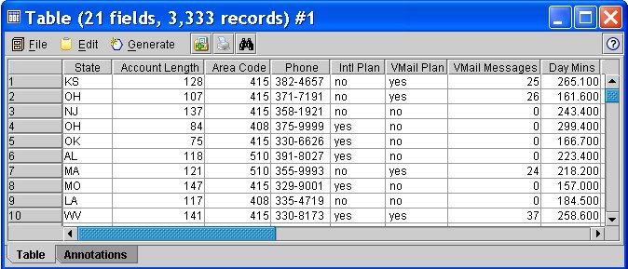
Getting to Know the Data Set
  Graphs, plots, and tables often uncover important relationships in data
  Raw data: 3,333 records and 20 variables in churn data set are explored (UCI Repository of ML Databases)
  Clementine from SPPS, Inc. shows first 10 records from data set in Figure 3.1
  Simple approach looks at field values of records
MD-MIS 637-Fall 2020

Slide 6
Getting to Know the Data Set (cont’d)
  Eight attributes shown in Figure 3.1:
    State: categorical
    Account Length: numeric
    Area Code: categorical
    Phone: categorical
    Intl Plan: Boolean
    VMail Plan: Boolean
    Vmail Messages: numeric
    Day Mins: numeric
  “churn” attribute (not shown) indicates customers leaving one company in favor of another company’s products or services
MD-MIS 637-Fall 2020

Slide 7
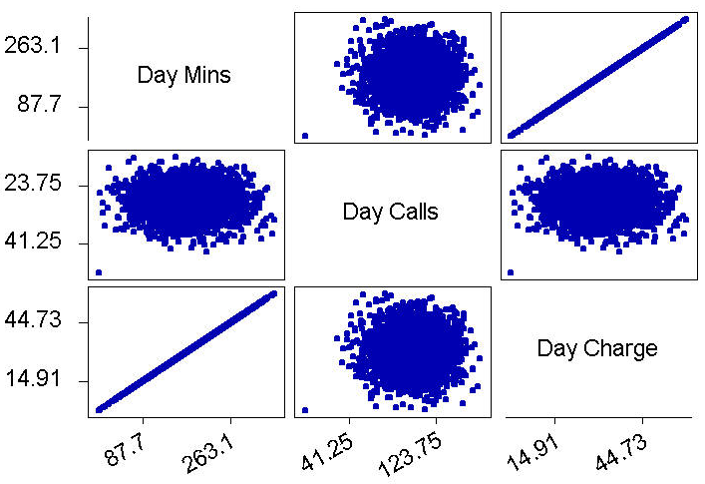
Dealing with Correlated Variables
Using correlated variables in data model:
  Should be avoided!
  Incorrectly emphasizes one or more data inputs
  Creates model instability and produces unreliable results
  Matrix plot of Day Minutes, Day Calls, and Day Charge shown in Figure 3.2 (Minitab)
MD-MIS 637-Fall 2020

Slide 8
Dealing with Correlated Variables (cont’d)
  As number of Day Minutes increase we expect Day Charge to increase
  Example of positive correlation
  Oddly, lack of graphical evidence supports correlation between Day Minutes and Day Calls, or Day Calls and Day Charge
  Additionally, r = 0.07 indicating variables uncorrelated
  However, linear relationship exists between Day Charge and Day Minutes
  Day Charge is linear function of Day Minutes
MD-MIS 637-Fall 2020

Slide 9
Dealing with Correlated Variables (cont’d)
Regression Analysis: Day Charge versus Day Mins
The regression equation is
Day Charge =0.000613 + 0.170 Day Mins
Predictor Coef SE Coef T P
Constant 0.0006134 0.0001711 3.59 0.000
Day Mins 0.170000 0.000001 186644.31 0.000
S = 0.002864 R-Sq = 100.0% R-Sq(adj) = 100.0%
  Estimated regression equation shown in Figure 3.3 (Minitab) expresses relationship
  “Day Charge equals 0.000613 plus 0.17 times Day Minutes”
  Company uses flat-rate billing model of 17 cents/minute
  R-squared statistic = 1.0 → indicates perfect linear relationship
  Therefore, Day Charge and Day Minutes are correlated
MD-MIS 637-Fall 2020

Slide 10
Dealing with Correlated Variables (cont’d)
  One of two variables should be eliminated from model
  Day Charge arbitrarily chosen for removal
  Evening, Night, and International variable pairs reflect similar results
  Therefore, Evening Charge, Night Charge, and International Charge also removed
  Proceeding to data mining without first eliminating correlated variables may have produced compromised results
  Number of attributes reduced from 20 to 16
  Reduction in dimensionality of solution space beneficial to some data mining algorithms
MD-MIS 637-Fall 2020

Slide 11
Exploring Categorical Variables
Goals: Exploratory Data Analysis
  Investigate variables as part of the Data Understanding Phase
    Numeric → Analyze Histograms, Scatter Plots, Statistics
    Categorical → Examine Distributions, Cross-tabulations,
    Web Graphs
  Become familiar with data
  Explore relationships among variable sets
  While performing EDA, remain focused on objective
  That is, creating data mining model of customer likely to “churn”
MD-MIS 637-Fall 2020

Slide 12
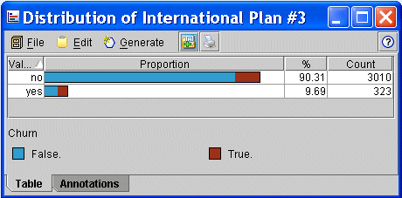
Exploring Categorical Variables (cont’d)
International Plan
  Figure 3.4 shows proportion of customers in International Plan with churn overlay
  International Plan: yes = 9.69%, no = 90.31%
  Possibly, greater proportion of those in International Plan are churners?
MD-MIS 637-Fall 2020

Slide 13
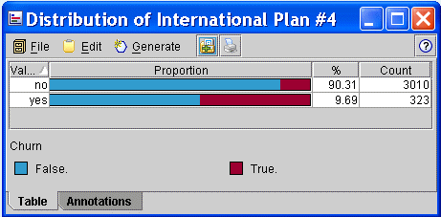
Exploring Categorical Variables (cont’d)
  Again, Proportion of customers in International Plan with churn overlay
  This time, same-sized bars used for each category (normalized)
  Graphically, proportion of “churners” in each category more apparent
  Those selecting International Plan more likely to churn
  However, relationship not quantified
MD-MIS 637-Fall 2020

Slide 14
Exploring Categorical Variables (cont’d)
  Cross-tabulation quantifies relationship between Churn and International Plan
  International plan and Churn variables both categorical
    First column: total → International plan = “no”
    Second column: total → International plan = “yes”
    First row: total → Churn = “False”
    Second row: total → Churn = “True”
  Data set contains 346 + 137 = 483 churners, and 2,664 + 186 = 3,010 non-churners
Churn | no | yes
False. | 2,664 | 186
True. | 346 | 137
MD-MIS 637-Fall 2020

Slide 15
Exploring Categorical Variables (cont’d)
  Therefore, quantifying the relationship:
  42.4% of customers in International Plan churned (137 / (137 + 186))
  11.5% of customers not in International Plan churned (346 / (346 + 2,664))
  Customers selecting International Plan more than 3X likely to leave company, as compared to those not in plan
  Why does International Plan apparently cause customers to leave?
  Data models predicting churn will likely include International Plan as predictor
MD-MIS 637-Fall 2020

Slide 16
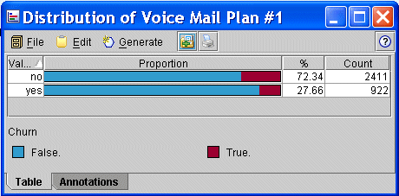
Exploring Categorical Variables (cont’d)
Voice Mail Plan
  Figure 3.7 shows proportion of customers in Voice Mail Plan with churn overlay (normalized)
  Voicemail Plan: yes = 27.66%, no = 72.34%
  Those not participating in Voice Mail Plan appear more likely to churn
MD-MIS 637-Fall 2020

Slide 17
Exploring Categorical Variables (cont’d)
Churn | No | yes
False. | 2,008 | 842
True. | 403 | 80
  Cross-tabulation quantifies relationship between Churn and Voice Mail Plan
    First column: total → Voice Mail Plan = “no”
    Second column: total → Voice Mail Plan = “yes”
    First row: total → Churn = “False”
    Second row: total → Churn = “True”
  Voice Mail Plan has 842 + 80 = 922 customers
  Remaining 2,008 + 403 = 2,411 customers not in plan
MD-MIS 637-Fall 2020

Slide 18
Exploring Categorical Variables (cont’d)
  Only 8.7% = 80/922 of those in plan are churners
  Of those not in plan, 16.7% = 403/2,411 are churners
  Therefore, those not participating in plan ~2X likely to churn, as compared to those in plan
  Perhaps customer loyalty can be increased by simplifying enrollment into Voice Mail Plan?
  Data models predicting churn likely to include Voice Mail Plan as predictor
MD-MIS 637-Fall 2020

Slide 19
Summary
  EDA uncovered some insights into churn data set:
    Four “Charge” fields are linear functions of “Minutes” fields
    Correlation among remaining numeric attributes “Weak”
    Area Code and/or State fields anomalous
    Customers with International Plan churn at higher rate
    Those in Voice Mail Plan churn less frequently
    Customers calling customer service 4 or more times churn 4X higher than others
    Customer with high day and evening minutes churn 4X higher rate than others
  These observations performed using EDA only; no data mining applied
  Results can be easily formulated into actionable plan designed to reduce churn rate
MD-MIS 637-Fall 2020

